Slide 1
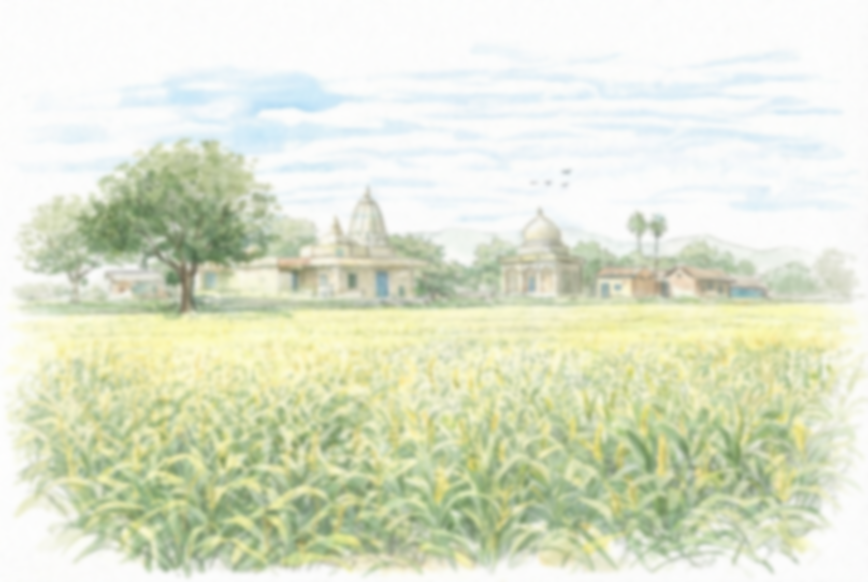
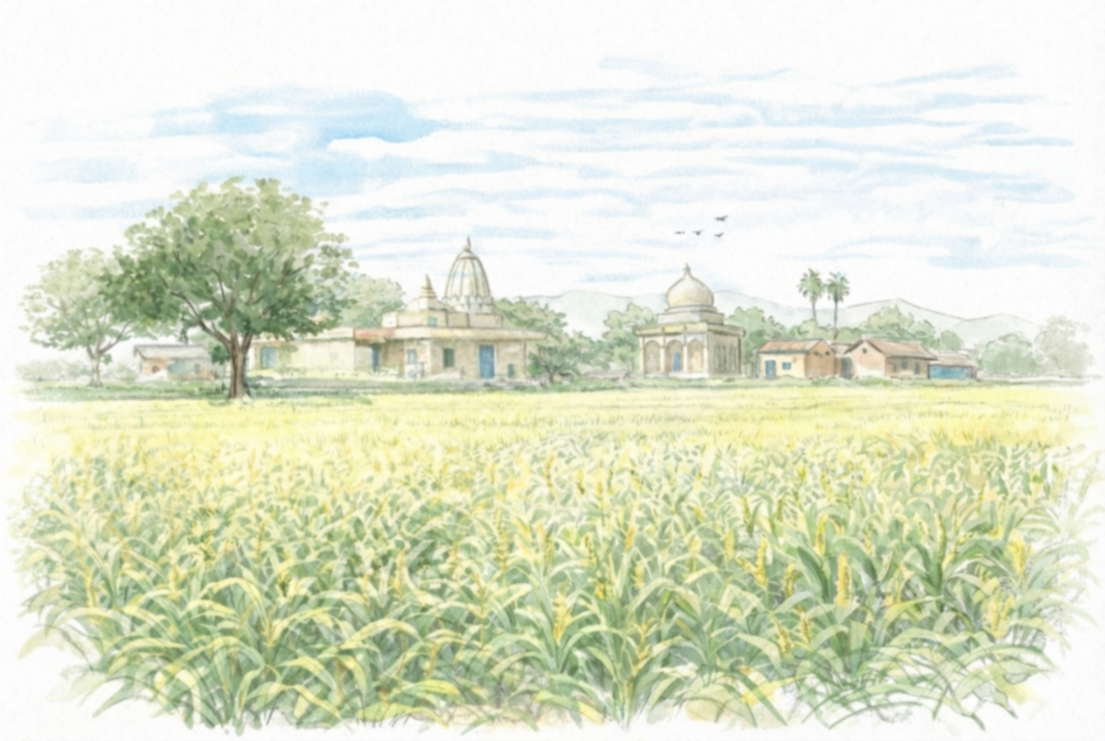
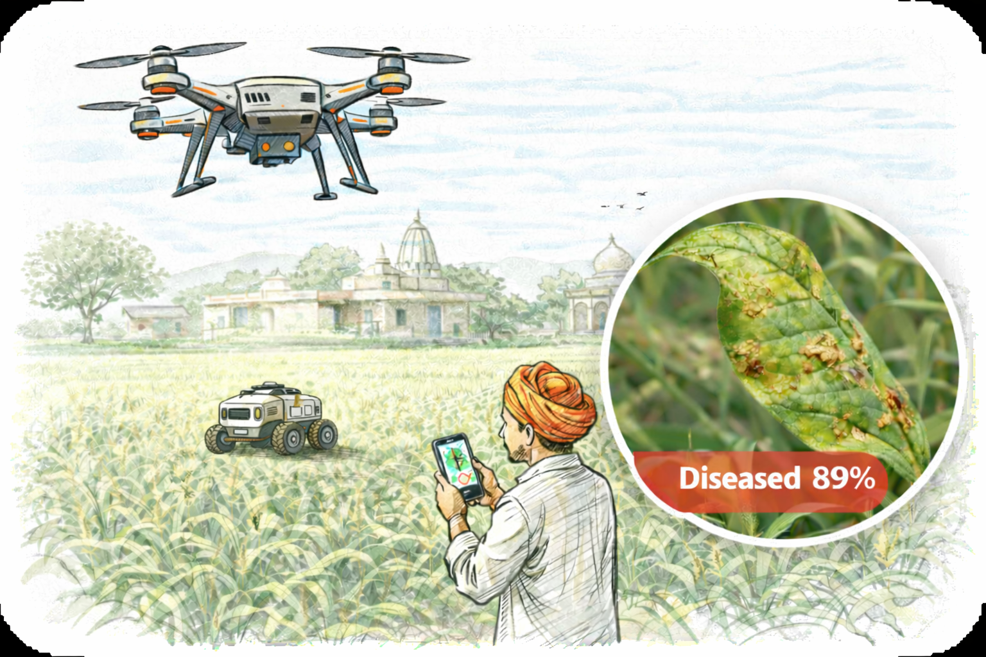
DHARA
VAIDYA
Har फसल Ka Apna Doctor.
Team- FLAG SMASHERS

Slide 2
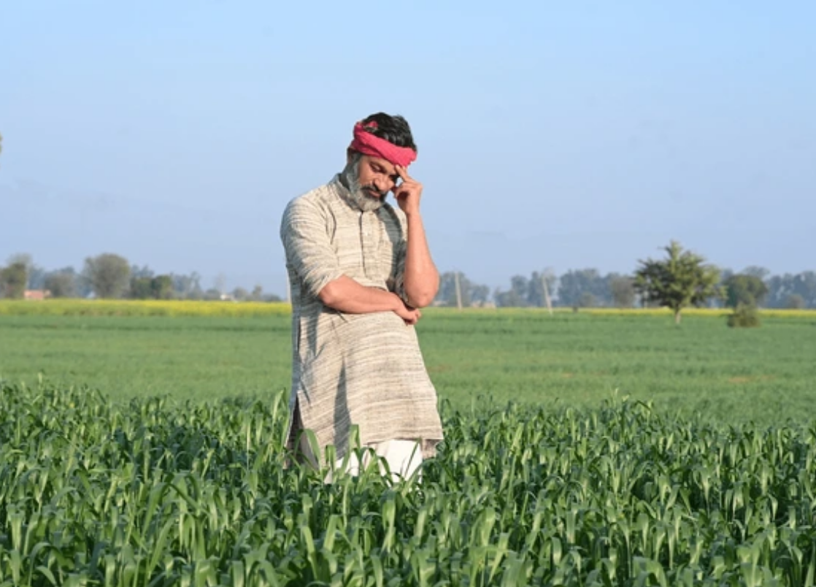




PROBLEM STATEMENT
Challenge of Turning Every Smartphone into a Smart Crop Doctor
Global Crop Loss- Diseases destroy up to 40% of crop yield worldwide.
Risk to Every Farmer- Pests and diseases are widespread, making most farmers vulnerable.
Major Financial Loss (India)- Farmers lose 15–25% income each season due to crop failure.
Core Issue Late Detection- Delayed identification leads to large-scale damage and preventable losses.
Farmers don’t lose crops because solutions don’t exist — they lose them because detection happens too late

Slide 3
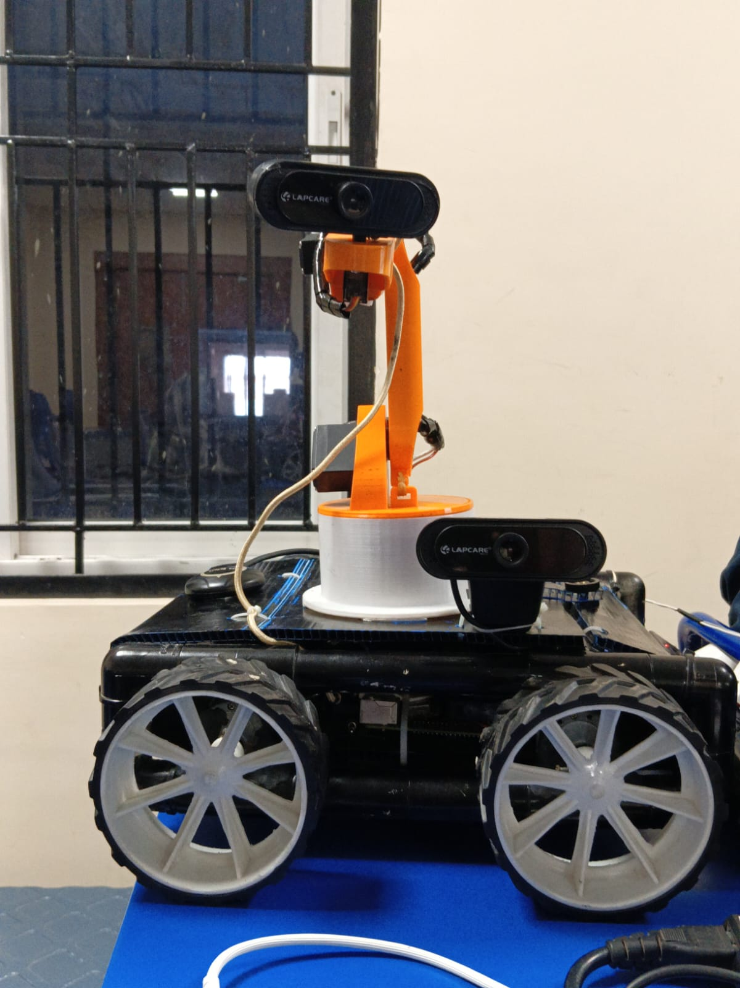
SOLUTION !
DHARA VAIDYA
Early Disease Detection- Identifies crop diseases quickly to prevent major losses.
AI-Powered Diagnosis- Provides accurate, Indian data-driven insights for better decisions.
Localized Treatment Advice- Delivers region-specific guidance in the farmer’s preferred language.
Smart Field Monitoring- Uses images, drones, and rover for precise crop health analysis.
Higher Yield, Lower Loss- Helps farmers protect crops, reduce waste, and increase income.

Slide 4
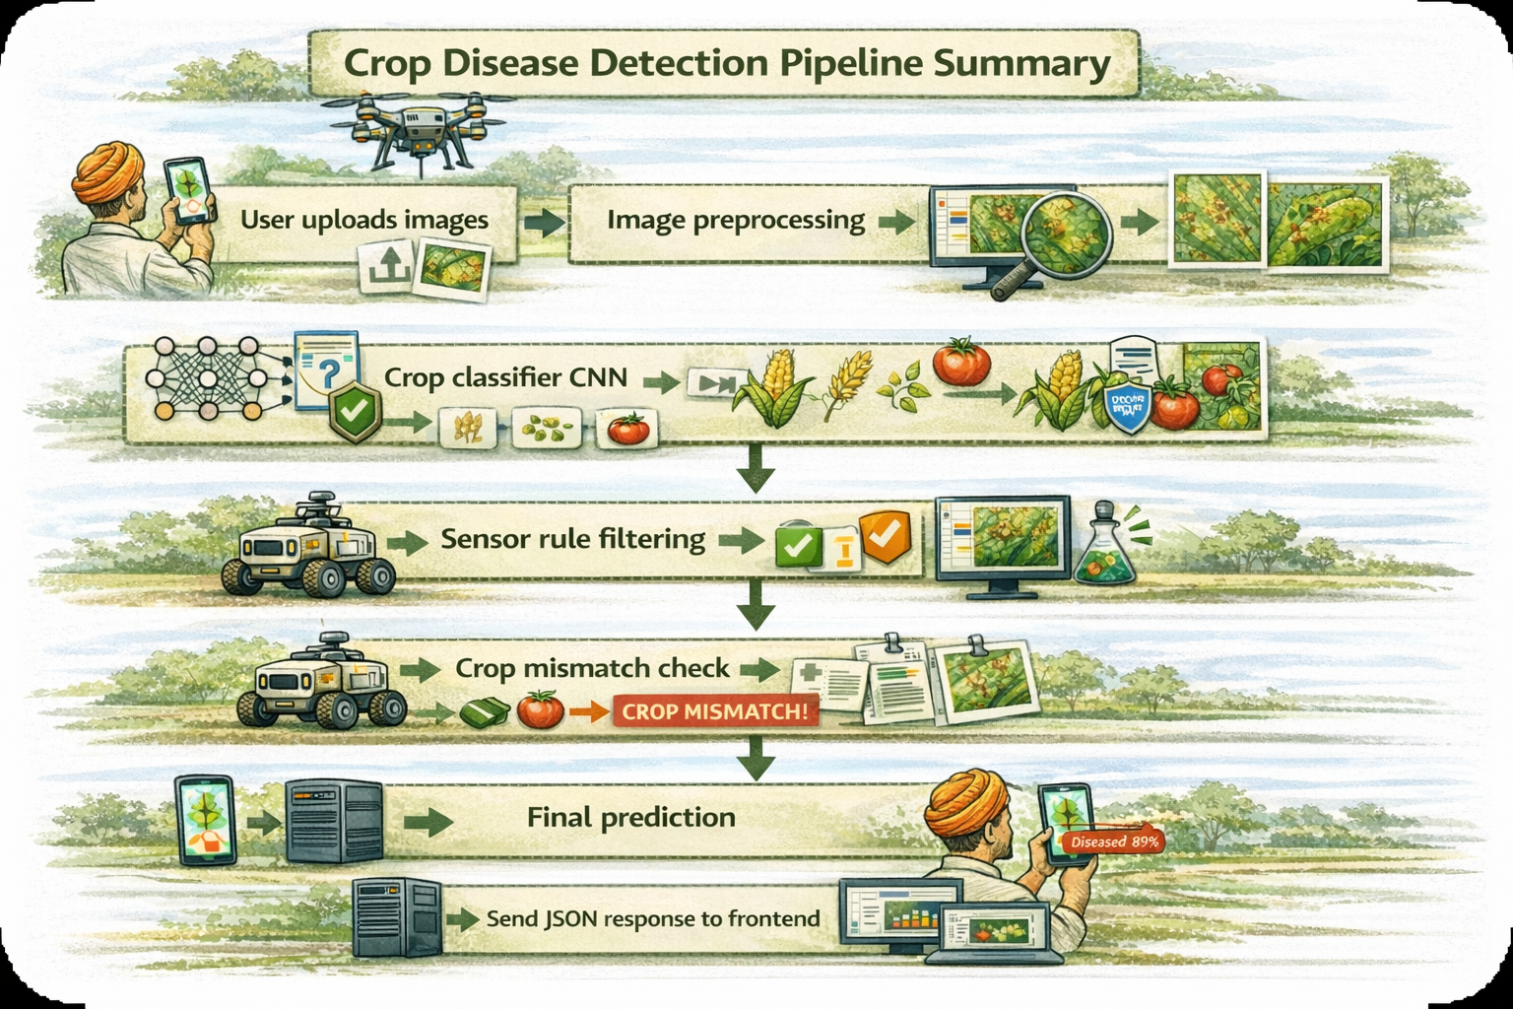
FLOW OF SOLUTION

Slide 5
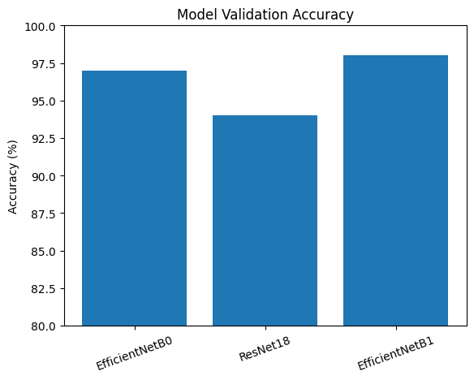
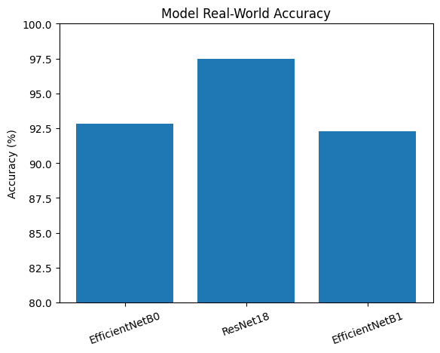
COMPARING DIFFERENT CNN ARCHITECTURES
#Training Dataset collected from India ,Bangladesh ,Pakistan & Nepal regions
#Major production crop models trained for RICE,WHEAT,SUGARCANE,POTATO.

Slide 6
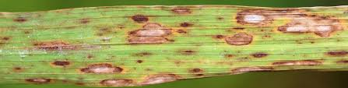
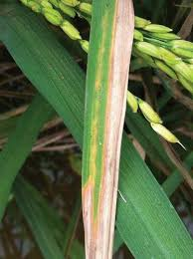
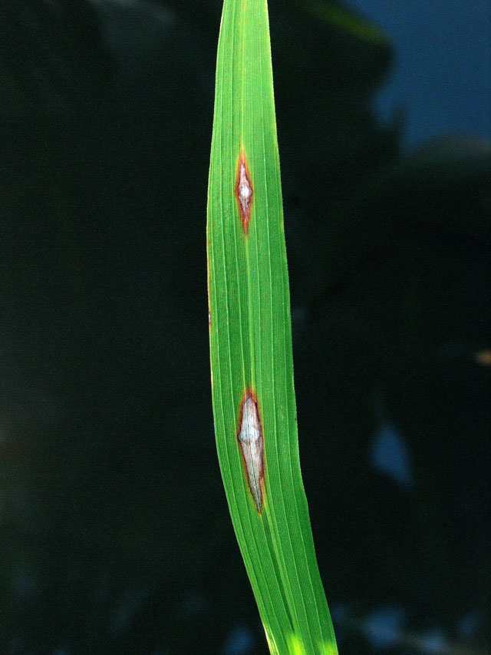
HOW ROVER PREDICTION WORKS
BROWN SPOT
BLIGHT
Major competitor-
Plantix
Can develop into 2 different diseases
Plantix only provides the classification of diseased crops taking only a single input without doing image quality scoring.
Rover take live environmental data from farm like temperature ,humidity, mineral values and then rules out the possible diseases that can occur.
We recommend farmers to input multiple images (>5)
We do image quality scoring and then add its weightage to final classification. We also do prediction through our rover using environmental data collection and processing.
Disease=?
Temperature=33 Nitrogen = 243 Humidity =120 UV Index = 9

Slide 7
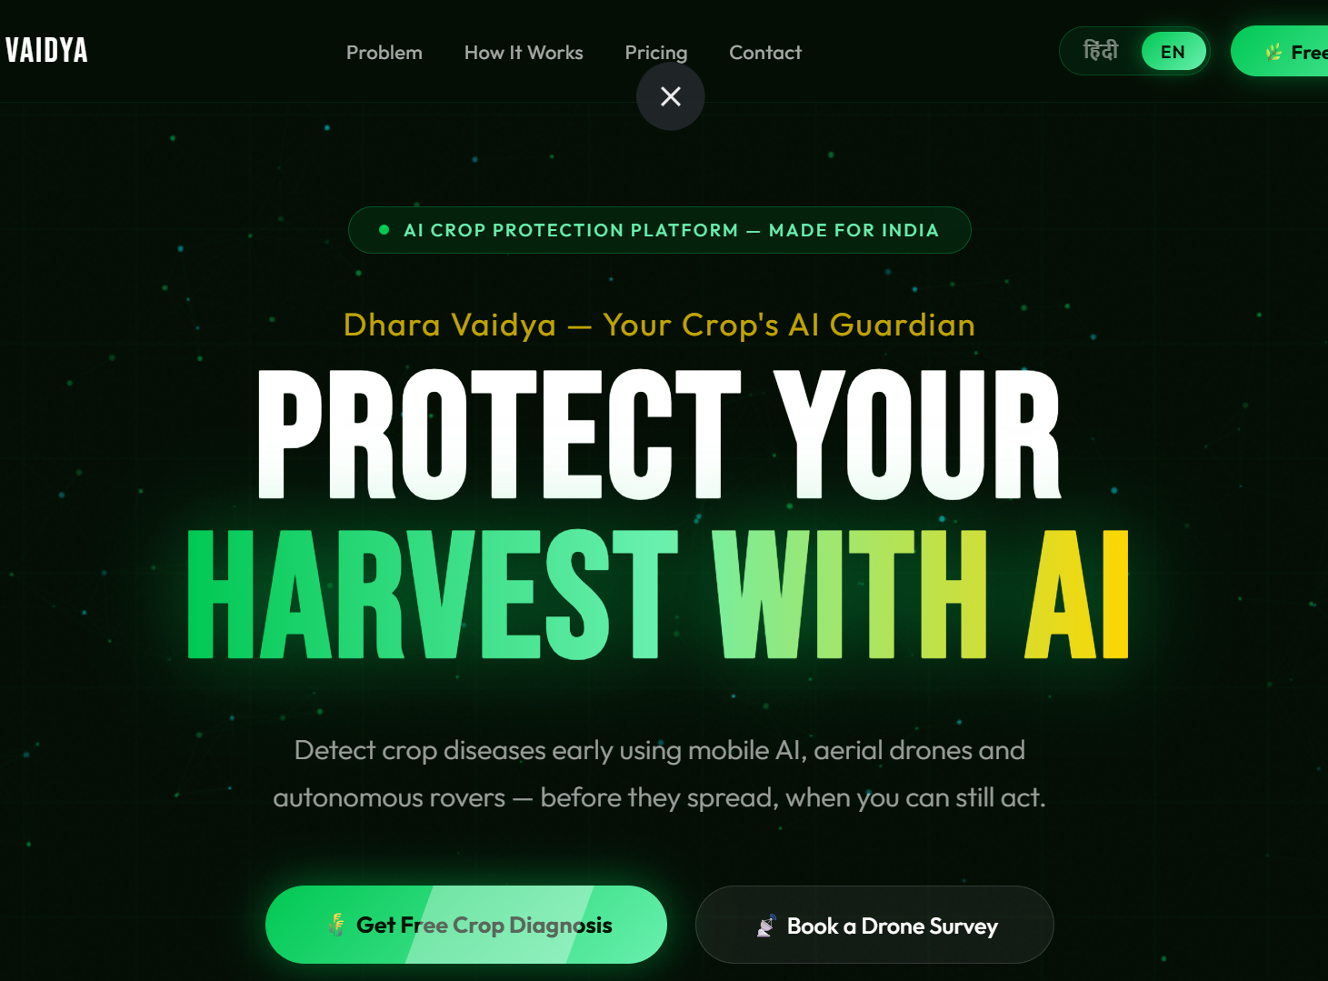

BUSINESS ARCHITECTURE
#Dhara Vaidya
Drone Survey Cost =₹299/Acre Rover Price = ₹10,000
#Will partner with multiple government Kisaan Yojna schemes and promote our products through local panchayat in villages.
#Will be providing affiliate links to farm products manufacturers like pesticides ,herbicides etc.

